Slide 1
Strategic and Financial Planning
UPRD Workshop – January 31, 2023

Slide 2
Agenda
Strategic Planning Background
Mission, Vision, Core Values
Strength/Weaknesses
Strategic KPIs
UPCC Performance
Benchmarks vs. Other Clubs
Performance vs. 2020 Strategic KPIs
5- Year Horizon
Assumptions
Projections – Membership Unconstrained/Constrained
Decisions to be Made
Capital Needs – Current and Future
Sources and Uses
Next Steps
Implications and Strategic Issues - 2023

Slide 3
Strategic Planning Background

Slide 4
Our Mission
Deliver to members and guests ever evolving lifestyle experiences that are engaging and inclusive by providing exemplary service, facilities and amenities.
Our Vision
To be the preeminent gathering place for members and guests to meet, socialize and enjoy lifestyle opportunities that exceed their expectations in a modern club environment that enhances our residential community.
Our Core Values
Values that are truly important direct the decisions we make, define our character, and preserve what is special about our Club. They are:
Integrity, Trust & Mutual Respect - Acting ethically in the best interests of our members, staff, and community. Quality -Striving to be the best that we can be in all that we do. Fiscal Responsibility and Transparency – Openly communicating our financial position and ensuring that operating budgets and reserves are sufficient to meet the current and future financial needs of the Club. Environmental stewardship – Commitment to preserving our natural landscape and considering the environmental impact of our decisions.

Slide 5
Key Strategic Performance Indicators
Member satisfaction
Membership growth/Membership retention
Member/Guest participation
Staff satisfaction/retention
Financial strength/accountability
Long-term Property values

Slide 6
Strengths and Weaknesses -2020
Top 5 Strengths in Rank Order | Top 5 Weaknesses In Rank Order
Great staff Excellent golf course Service Friendly, social membership Financial Strength | Limited Capital Income Outdated facilities Apathy/Resistance to change Lack of certain amenities Aging membership

Slide 7
Threats and Opportunities-2020
Top Threats in Rank Order | Top Opportunities In Rank Order
Not attracting new members Cost of upgrades to course and facilities Competition from newer communities Aging membership Economy Diminishing interest in golf Residents not understanding the correlation between a great club and home values | Identify new sources of capital income Clubhouse renovations Marketing Increase casual dining areas Increase amenities, i.e. pickleball, aquatics, fitness, etc. Increase member participation Increase events

Slide 8
Key Strategic Issues - 2020
Key Strategic Issues in Rank Order - Fall 2020
Update facilities Financial health Membership growth Strategic planning Governance and Leadership Maintaining property values Member participation/usage Member retention Obtaining quality staff members

Slide 9
UPCC Performance
Sources:
Club Benchmarking
18-27 holes, Southeast US, 68 Clubs, Multi-year Data
Phillips Harvey
South and Southwest Florida, 61 Clubs Audited

Slide 11
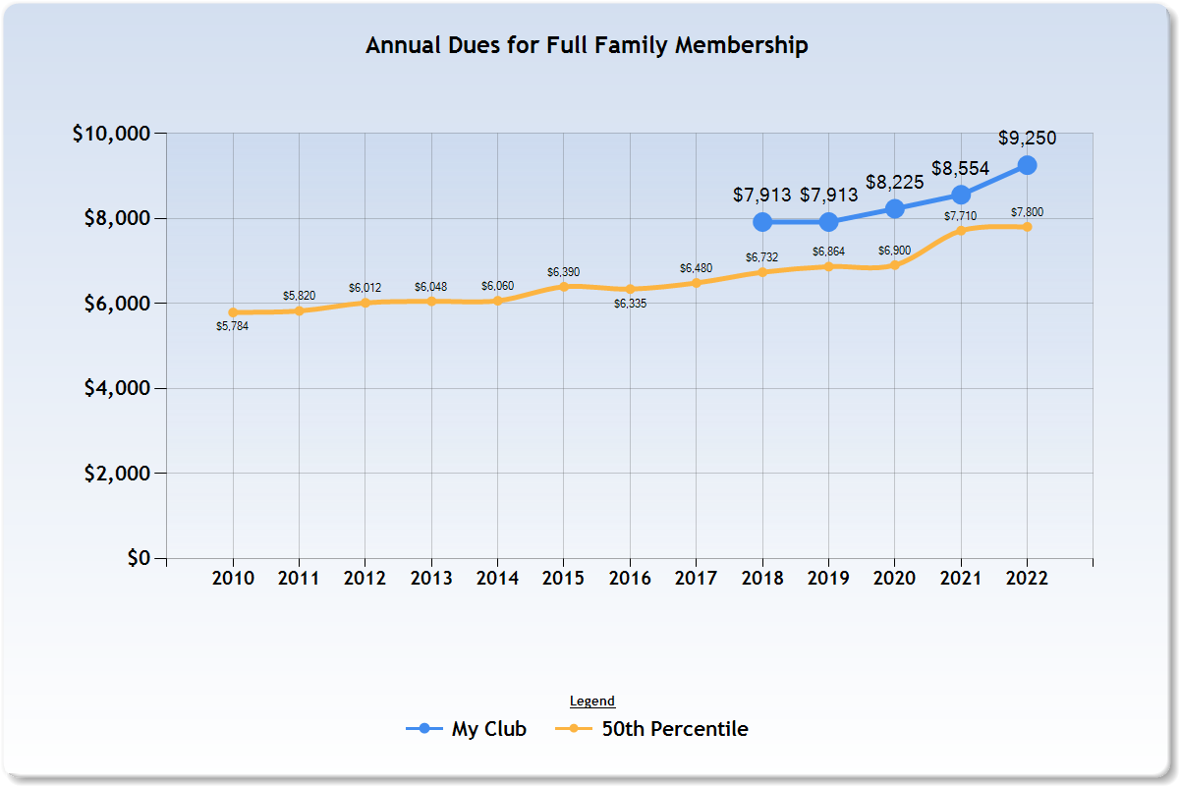

Slide 12
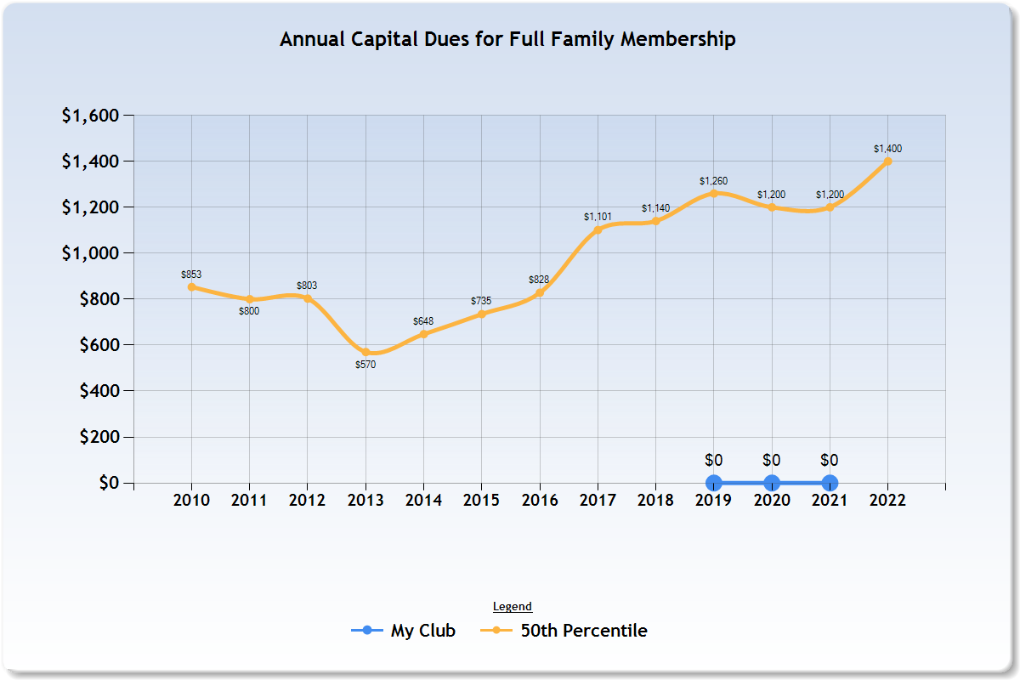

Slide 13
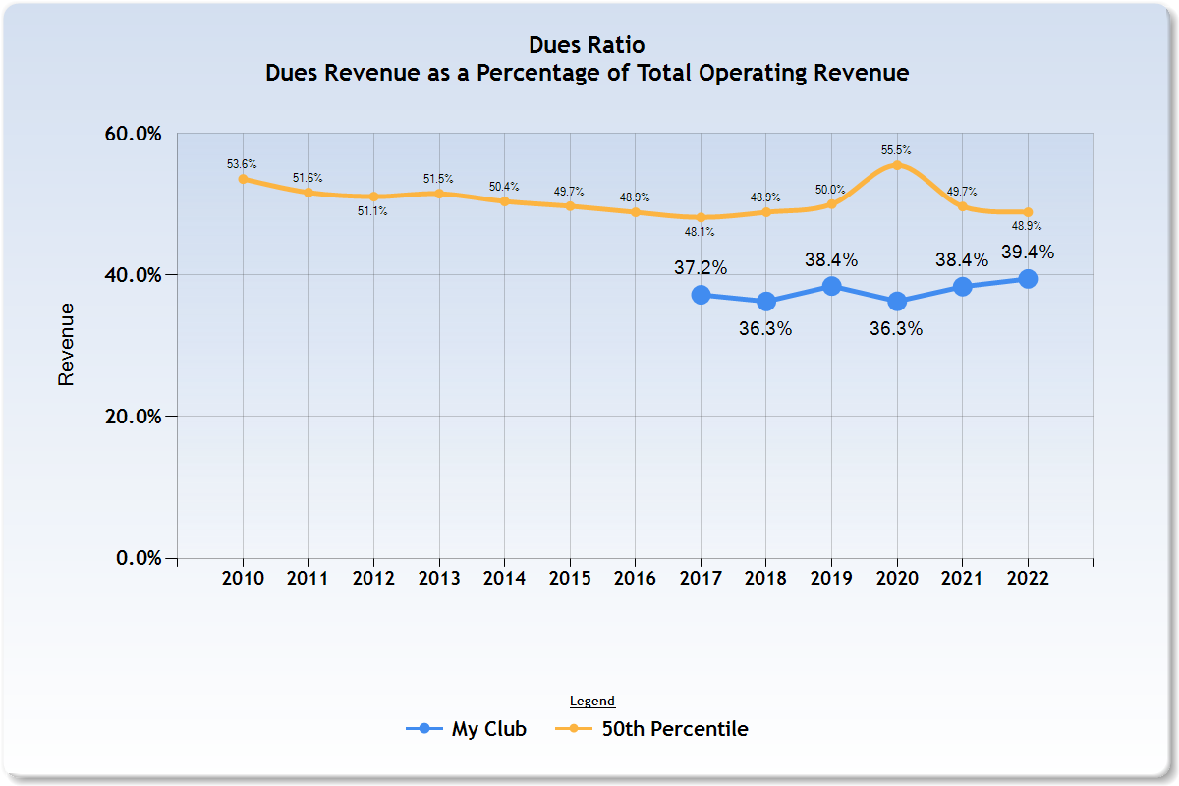

Slide 14
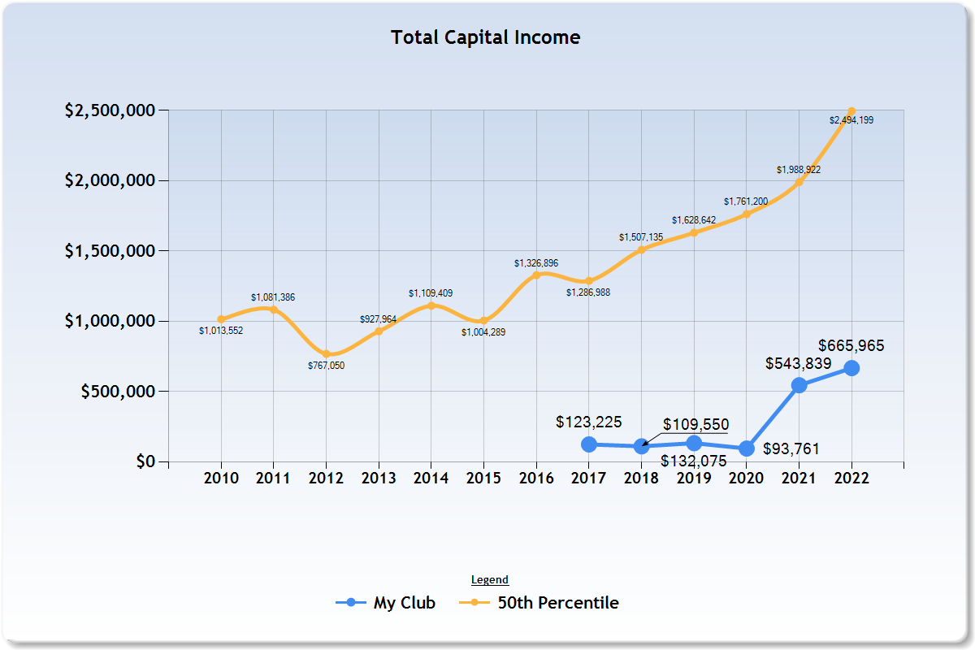

Slide 15
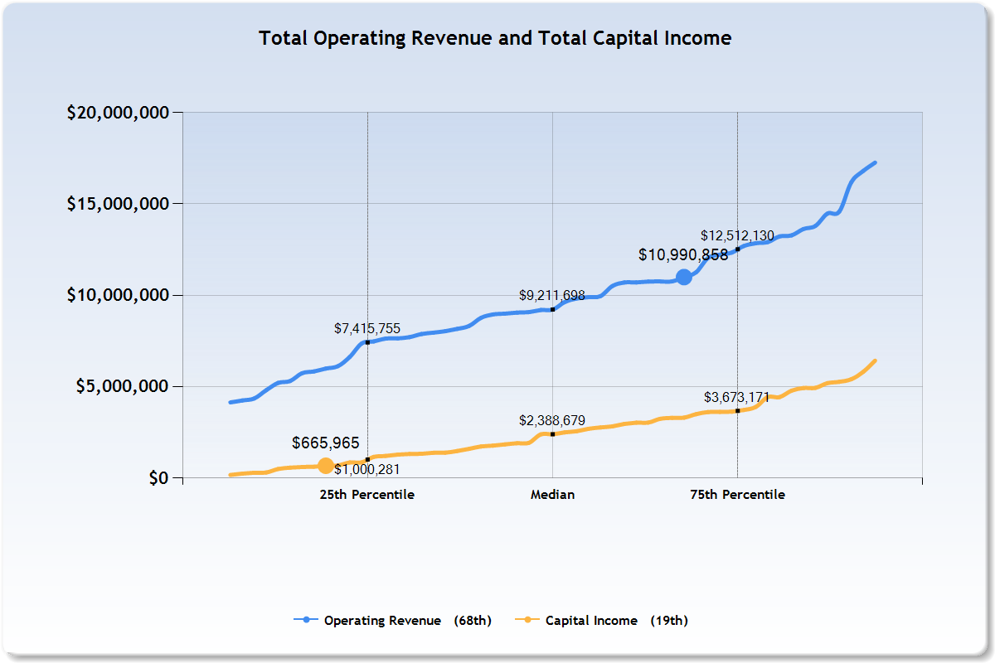

Slide 16
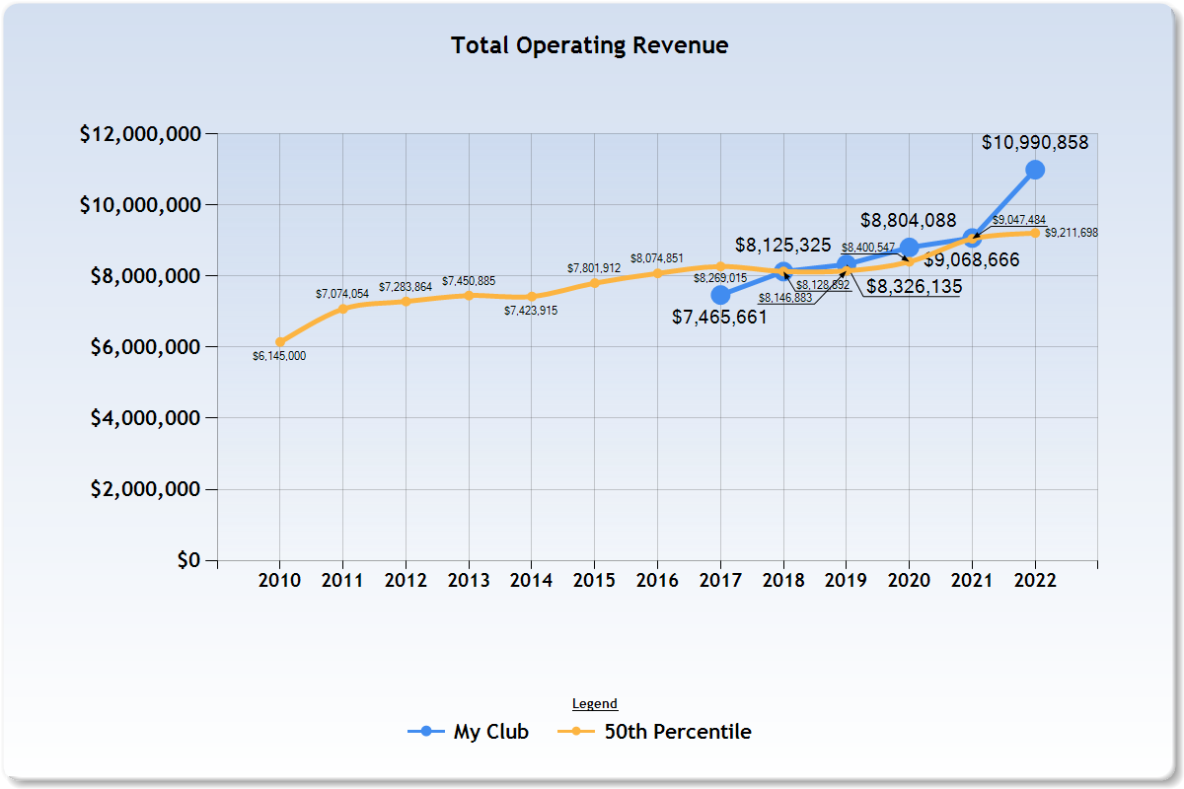

Slide 17
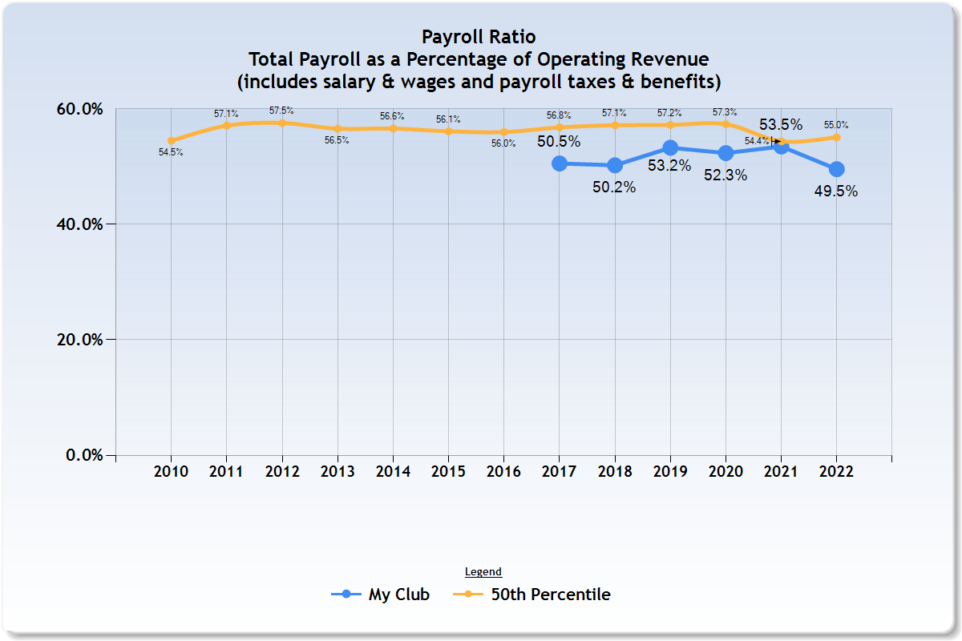

Slide 18
University Park Country Club
Golf Course Maintenance per 18-Hole Equivalent

Slide 19
University Park Country Club
G&A Expenses per Revenues

Slide 20
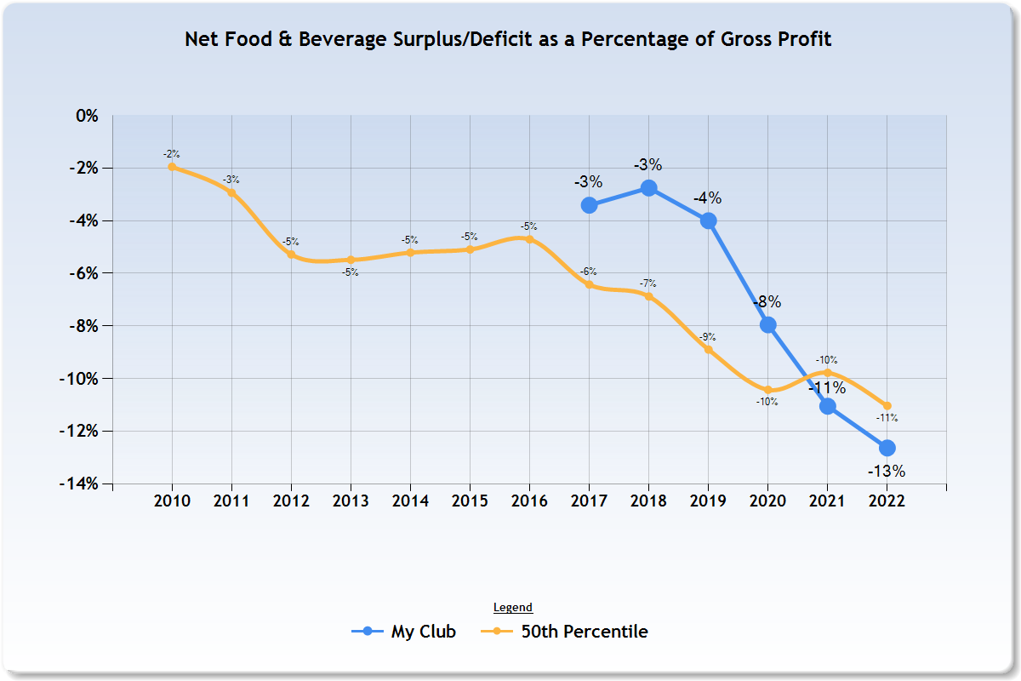

Slide 21
Takeaways from UPCC Benchmarking Performance vs. Strategic Initiatives 2020
Membership has grown
Operating revenue has grown
Our annual Capital Income is lower than reference clubs
Full Member Initiation Fees Lower than Comparable Clubs
We are generating less Capital than other Clubs
Financial KPIs (Gross Profit/Fixed Expense/Payroll Expense, etc.) all in line with other Clubs
Golf Course management consistent; G&A consistent
F&B Subsidy consistent with other clubs; but accelerating
Management and F&B Department identified high cost of food (investigating purchasing, labor input, waste, other)

Slide 22
Five – Year Horizon

Slide 23
Five Year Pro Forma Assumptions – No Membership Constraint
Full members increase to 440 by 2027, resulting in:
Outside annual rounds decreasing by ~50% by 2027
Outside golf revenue decreasing by ~45% by 2027
Outside play rounds reduced by 200 for each added full member
Racquets Members to 149; Social to 862; Total 1451
Total ~ 2,375 people
Social membership includes Fitness/Wellness beginning in 2026, with personnel added in 2026 to support change
Otherwise à la carte ‘Pass’ System Remains in Place

Slide 24
Five Year Pro Forma Assumptions – No Membership Constraint, page 2
Annual Increase Assumptions
4% annual increase in Dues
4% annual increase in payroll
3% increase in other expenses
Maintenance, utilities, insurance, prorated per ft.² for W/F and Space
What Is Not Assumed
No significant difference in demand for outside golf.
No change in required Memberships or F&B Minimum
No significant change in restaurant covers
No significant change on Social Member Dues (considered low by competitive standards)
No significant increase in Initiation fees
No significant change in revenue from Summer Memberships

Slide 25
SUMMARY INCOME STATEMENT |  |  | Five Year Forecast
FISCAL YEARS ENDING SEPTEMBER 30 |  |  | 2023 |  | 2024 |  | 2025 |  | 2026 |  | 2027
COUNTRY CLUB OPERATIONS:
(in thousands)
REVENUE:
MEMBERSHIP DUES |  |  | 4,894 |  | 5,443 |  | 5,948 |  | 6,470 |  | 6,830
GOLF OPERATIONS, NET |  |  | 3,454 |  | 3,028 |  | 2,885 |  | 2,653 |  | 2,609
TENNIS & FITNESS CENTRE |  |  | 95 |  | 98 |  | 101 |  | 104 |  | 107
RESTAURANT INCOME |  |  | 2,390 |  | 2,462 |  | 2,535 |  | 2,611 |  | 2,689
TOTAL REVENUE |  |  | 10,833 |  | 11,031 |  | 11,470 |  | 11,839 |  | 12,236
EXPENSES:
GOLF OPERATIONS |  |  | 1,578 |  | 1,653 |  | 1,728 |  | 1,804 |  | 1,847
TENNIS & FITNESS CENTRE |  |  | 485 |  | 503 |  | 521 |  | 650 |  | 674
RESTAURANT |  |  | 3,174 |  | 3,285 |  | 3,399 |  | 3,518 |  | 3,641
GOLF COURSE MAINTENANCE |  |  | 3,140 |  | 3,251 |  | 3,366 |  | 3,485 |  | 3,608
GENERAL & ADMINISTRATIVE |  |  | 2,015 |  | 2,092 |  | 2,171 |  | 2,253 |  | 2,339
TOTAL EXPENSES |  |  | 10,393 |  | 10,783 |  | 11,185 |  | 11,710 |  | 12,109
FUNDING OF UPRD GENERAL FUND |  |  | (90) |  | (100) |  | (150) |  | (100) |  | (100)
SURPLUS/(LOSS) FOR OTHER RD NEEDS |  |  | 350 |  | 148 |  | 135 |  | 29 |  | 27
CAPITAL FUNDS: |  |  | 1,025 |  | 1,033 |  | 1,033 |  | 1,030 |  | 1,043

Slide 26
Five Year Pro Forma Assumptions Membership Constrained
No significant changes from “membership not constrained forecast”
All Prior Assumptions
Membership Caps: Full = 400; Racquets = 135, Social = 817
2,300 people
Does not include Trial Members – 2Q – FY (30 Full)

Slide 27
Capital Needs and Capital Reserves

Slide 28
Capital Reserve Study
Foundation for capital planning, 20-year horizon
Contracted with specialists in Golf/Country Clubs
Historic files and info; two people on-site for a week
Identified all assets > $2,500 in value, date installed, useful life
Includes all golf course components, racquets, fitness/wellness, dining, kitchen, infrastructure
Curated by Curtis, John, et. al. for UPCC, leases considered
Projects replacement cost and funds needed by year (inflation considered)

Slide 29
CAPITAL SOURCES & USES, Years 1 – 5 Year 1 Year 2 Year 3 Year 4 Year 5

Slide 30
CAPITAL SOURCES & USES, Years 1 – 20 Years 1-5 Years 6-10 Years 11-15 Years 16-20

Slide 31
Implications and Strategic Issues - 2023

Slide 32
Implications/Conclusions
Club performance has positively advanced key strategic issues from 2020.
Membership constraints are manageable; it is a member experience decision.
Current initiation fees, capital dues, and 10% outside play are insufficient to support our EXISTING infrastructure.
We need an additional $10 - $13 million over the next 20 years to support EXISTING infrastructure, before new kitchen, wellness/fitness, activity space, pro shop move, and office needs.

Slide 33
Strategic Issues –2023
Issue | Decisions/Considerations | Strategic KPI Impacts
Membership | Growth, Caps, Requirements, Capacity | Member Satisfaction, Participation
Financial | Capital Requirements, Operating Performance | Fiscal Responsibility, Satisfaction, Property Values
Facilities | Aging Infrastructure, Amenity Deficiencies, Master Plan | Satisfaction, Participation, Property Values, Staff Satisfaction

Slide 34
Questions and Comments

